Slide 1



POSTMAN PHASE 1 HACKATHON MAR 2024
TEAM 4 POSTMAN VISIONARIES
Team Name: Postman Visionaries
Team Number: 4
Team Members
Sathya Gopinath - Team Lead
Bhuvaneswari.K.A
Harika VLS Malella
Rashmi Kula
Varshini Sathyamurthy

Slide 2

01
Understanding the Work Flow
02
Module Assignment & Gherkins
Journey of Phase 1 API Hackathon
03
Assigning tasks in Jira (Agile)
04
Working & Integrating the modules
05
Reports Generation
06
Final Documentation & Submission

Slide 3
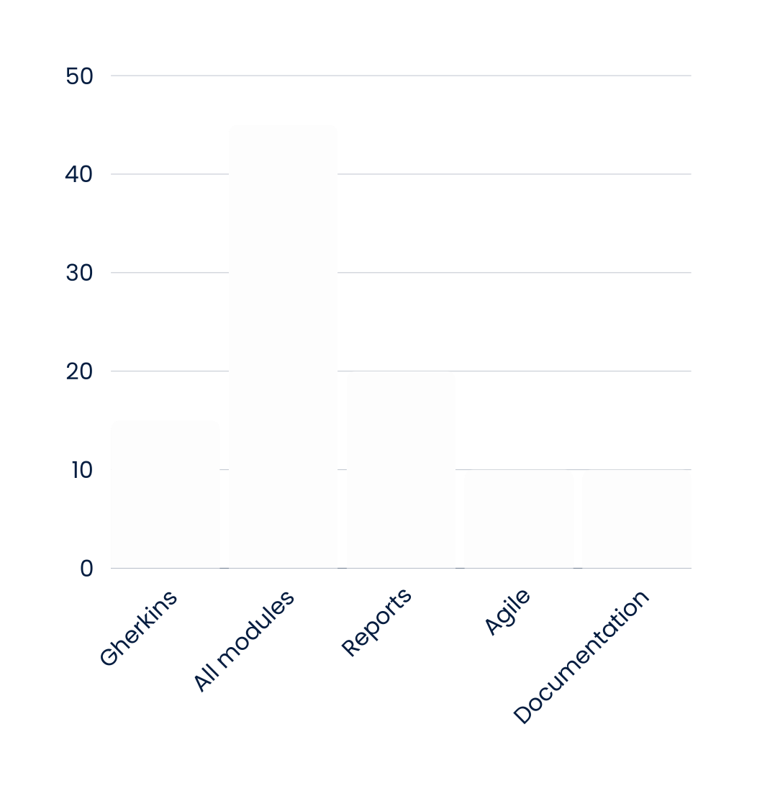
Work Distribution
15%
45%
Gherkins
All Modules
20%
10%
Reports
10%
Agile
Documentations

Slide 4
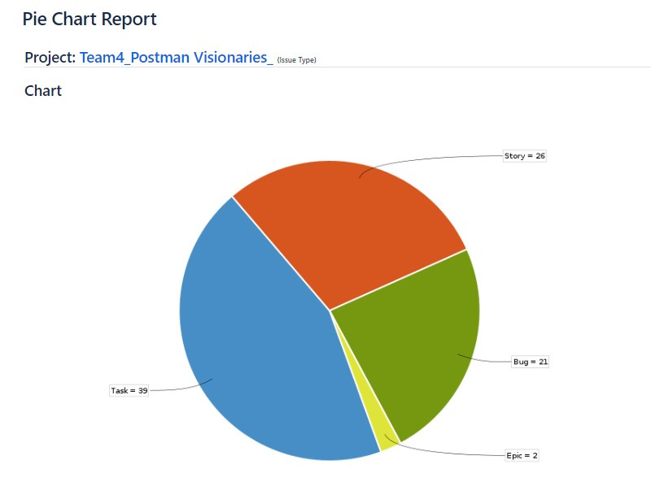
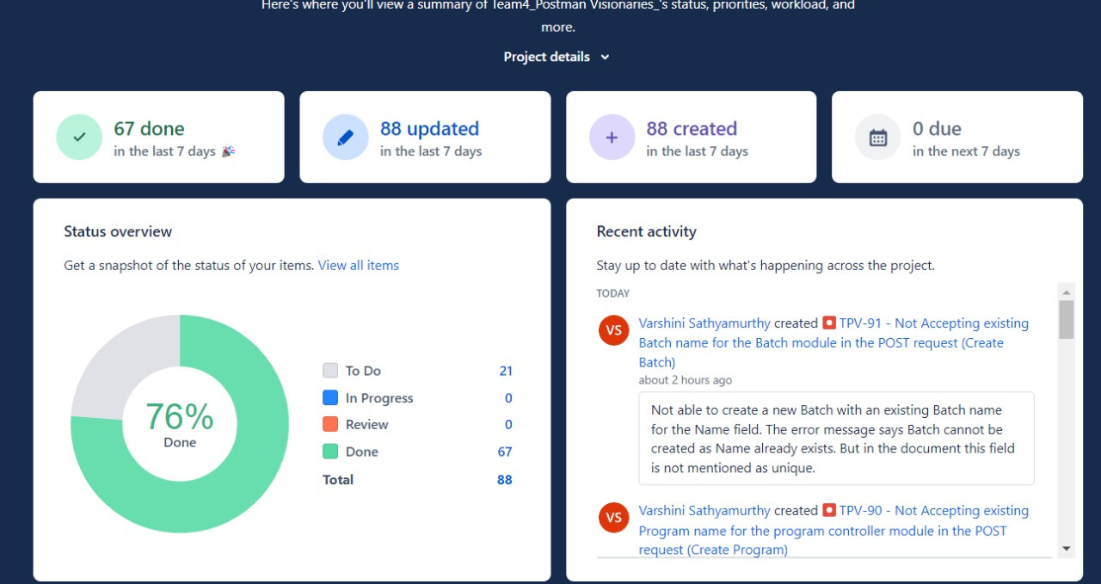
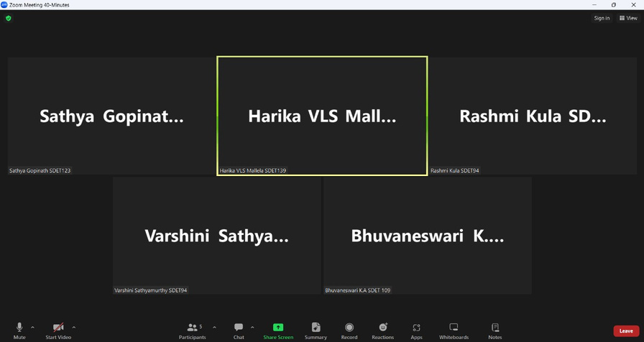
AGILE
Jira Report
Jira Summary Report
No. of Bugs found : 21
No. of Test cases [Gherkins] : 372
Total no. Positive Test cases : 54
Total no. negative Test cases : 318

Slide 5
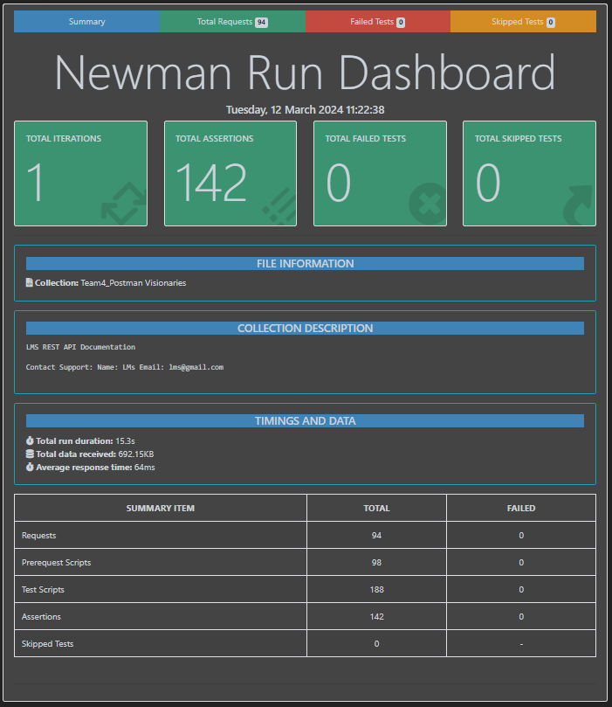
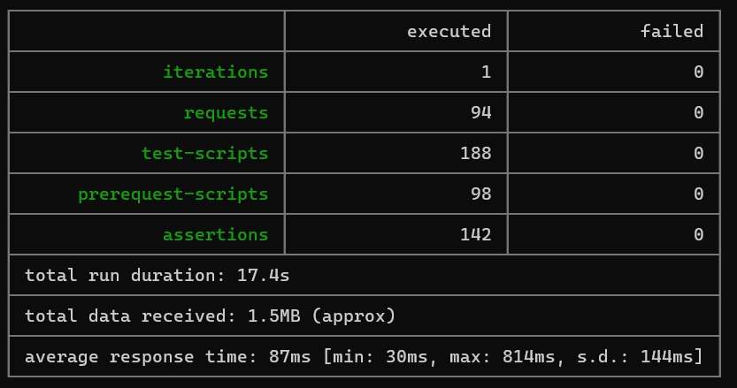
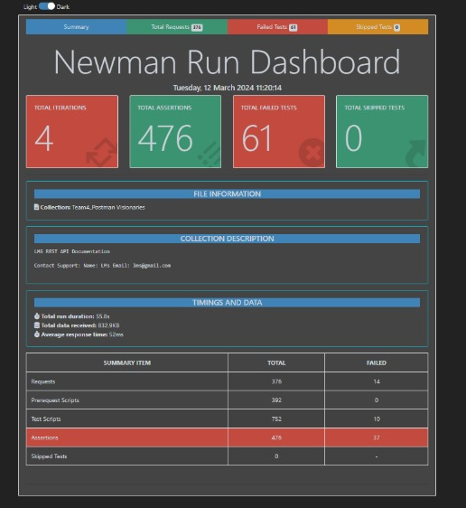
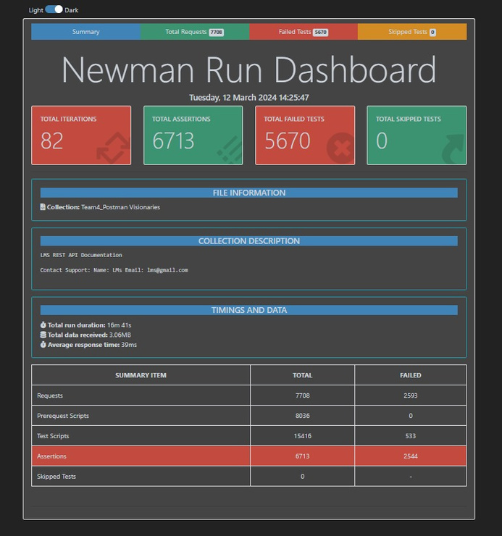
Reports
Newman Report
Jenkins Report
End to End Positive
Total Test cases

Slide 6

Challenges
Learnings
Single-sheet preparation of all test data
Creating a single collection of all modules
404 - Not found
Execution of requests with bulk Test data
Validating and storing data from response
Knowledge Sharing
Data Driven
Agile and Reports
Thank
you!

